Slide 1
Using Existing Datasets for TinyML

Slide 2
Don’t collect from scratch
Data collection is difficult!
Can we reuse existing data?
Notes:
We’ve now seen how challenging it can be to collect a brand new dataset
Can we possibly re-use existing datasets instead for new TinyML tasks? There’s a lot of datasets already available for non tinyML purposes
Can we adapt existing data to our task and still capture the important features that we would have specifically designed into a custom dataset?
What is missing from available data that your task might require in order to make your ML objective tractable?
Can you adapt your application or rethink exactly what problem you are solving?
Say you wanted to provide always-on FaceID - Instead of a single model providing FaceID, maybe you could design a two-stage architecture: a wakeword face detector, and a more powerful face verification model that runs in the cloud

Slide 3
Don’t collect from scratch
Data collection is difficult!
Can we reuse existing data?
What’s available?
What’s missing?
Notes:
We’ve now seen how challenging it can be to collect a brand new dataset
Can we possibly re-use existing datasets instead for new TinyML tasks? There’s a lot of datasets already available for non tinyML purposes
Can we adapt existing data to our task and still capture the important features that we would have specifically designed into a custom dataset?
What is missing from available data that your task might require in order to make your ML objective tractable?
Can you adapt your application or rethink exactly what problem you are solving?
Say you wanted to provide always-on FaceID - Instead of a single model providing FaceID, maybe you could design a two-stage architecture: a wakeword face detector, and a more powerful face verification model that runs in the cloud

Slide 4
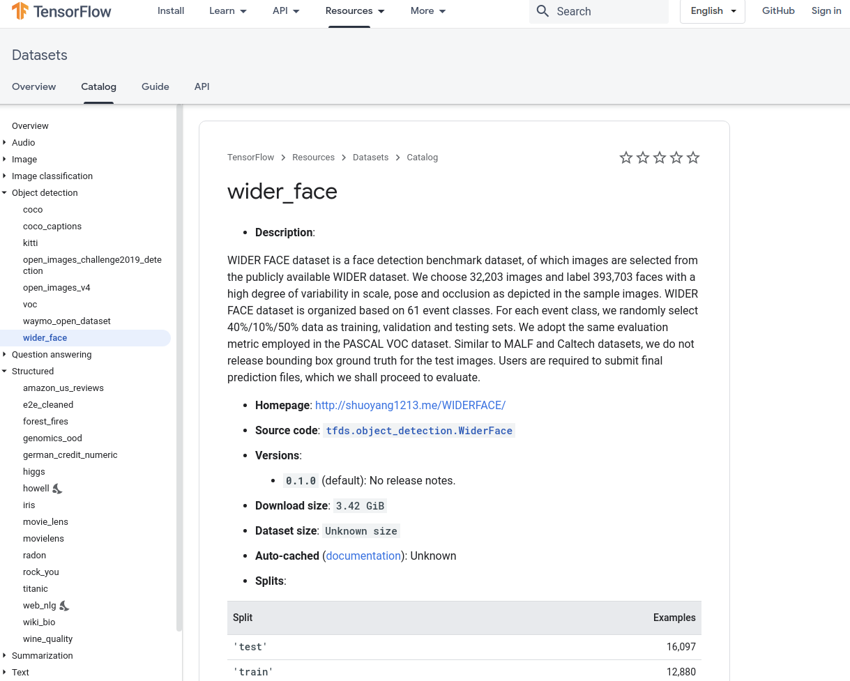
TensorFlow Datasets Catalog
Notes:
Consult the TF dataset catalog for a list of useful & popular already-curated datasets
https://www.tensorflow.org/datasets/catalog/wider_face

Slide 5
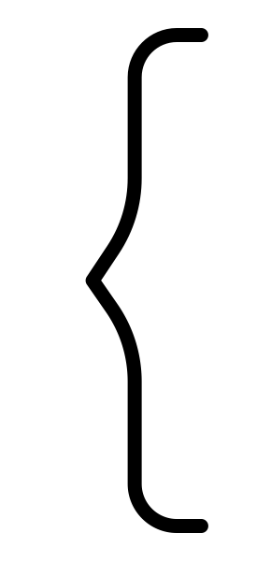
TensorFlow Datasets Catalog
Audio
Image
Image Classification
Object Detection
Question Answering
Structured
Summarization
Text
Translate
Video
Notes:
Consult the TF dataset catalog for a list of useful & popular already-curated datasets
https://www.tensorflow.org/datasets/catalog/wider_face
https://thenounproject.com/search/?q=bracket&i=2080250

Slide 6
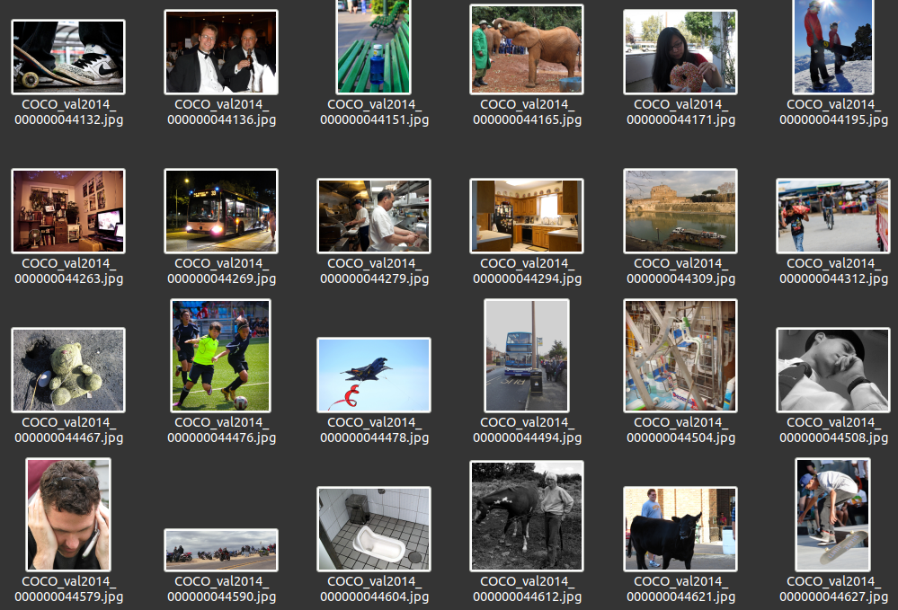
TinyML
Person Detection
Visual Wake Words: a new dataset built from Common Objects in Context (COCO)
people v. no people
Repurposing existing datasets for TinyML tasks is a powerful concept
Notes:
In the next section we will work on person detection, and we will see how it specializes an existing dataset
The Visual Wake Words (VWW) dataset was constructed from the large & popular Common Objects in Context (COCO) dataset
COCO is full of existing image data with information-rich labels
VWW selects images with people in frame and background images with no people
Uses bounding box/segmentation size for person class to ensure the person is close to the camera, resembling wake-words use case
You don’t always have to start collecting from scratch!

Slide 7
Don’t learn from scratch
Transfer learning
Notes:
In the next section we will also discuss Transfer learning
the important features for speech or vision processing are shared across many different tasks, we’ll look at this technique in the next section
Pretrained models save tons of time! Much faster to transfer features over than relearn from scratch
Reference that they saw a pretraining example train fast before
Pretrained models can also be used to help curate data for new tasks
ImageNet was built in part using results from google image search
A pretrained model can help curate your data (human + AI in-the-loop labeling) - for example, automated preprocessing for suggesting bounding boxes, or finding more keywords from unlabeled audio
Generate data from a simulator (Unity, Unreal, Physics engines like bullet/mujoco, ….)
Generative models can produce new data examples
Active area of research
Potential chicken-and-egg problem: training a generative model also requires a large amount of data

Slide 8
Don’t learn from scratch
Transfer learning
Pretrained models: your “AI Data Labeling Assistant”
Notes:
In the next section we will also discuss Transfer learning
the important features for speech or vision processing are shared across many different tasks, we’ll look at this technique in the next section
Pretrained models save tons of time! Much faster to transfer features over than relearn from scratch
Reference that they saw a pretraining example train fast before
Pretrained models can also be used to help curate data for new tasks
ImageNet was built in part using results from google image search
A pretrained model can help curate your data (human + AI in-the-loop labeling) - for example, automated preprocessing for suggesting bounding boxes, or finding more keywords from unlabeled audio
Generate data from a simulator (Unity, Unreal, Physics engines like bullet/mujoco, ….)
Generative models can produce new data examples
Active area of research
Potential chicken-and-egg problem: training a generative model also requires a large amount of data

Slide 9
Don’t learn from scratch
Transfer learning
Pretrained models: your “AI Data Labeling Assistant”
Generate your own data
Simulations
ML models
Notes:
In the next section we will also discuss Transfer learning
the important features for speech or vision processing are shared across many different tasks, we’ll look at this technique in the next section
Pretrained models save tons of time! Much faster to transfer features over than relearn from scratch
Reference that they saw a pretraining example train fast before
Pretrained models can also be used to help curate data for new tasks
ImageNet was built in part using results from google image search
A pretrained model can help curate your data (human + AI in-the-loop labeling) - for example, automated preprocessing for suggesting bounding boxes, or finding more keywords from unlabeled audio
Generate data from a simulator (Unity, Unreal, Physics engines like bullet/mujoco, ….)
Generative models can produce new data examples
Active area of research
Potential chicken-and-egg problem: training a generative model also requires a large amount of data

